Slide 1
CAP275: Data Communication and Networking Unit-2: Physical Layer –Multiplexing

Slide 2
MULTIPLEXING
Whenever the bandwidth of a medium linking two devices is greater than the bandwidth needs of the devices, the link can be shared.
Multiplexing is the set of techniques that allows the (simultaneous) transmission of multiple signals across a single data link.
As data and telecommunications use increases, so does traffic.
Frequency-Division Multiplexing
Wavelength-Division Multiplexing
Time-Division Multiplexing

Slide 3
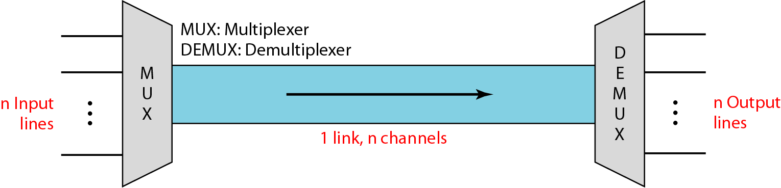
Dividing a link into channels

Slide 4
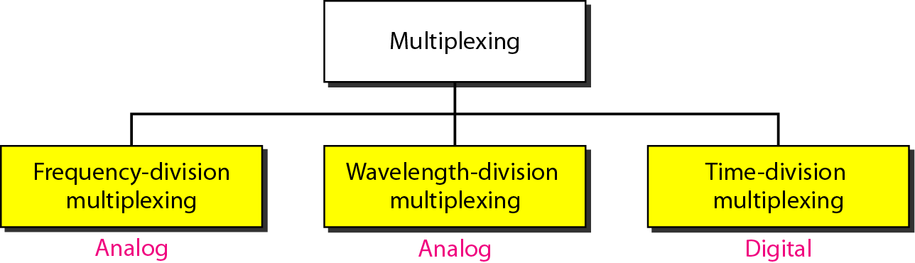
Categories of multiplexing

Slide 5
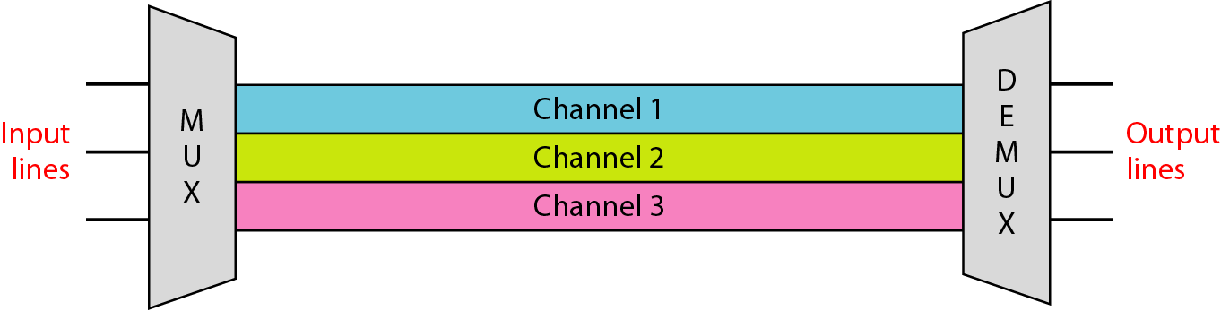
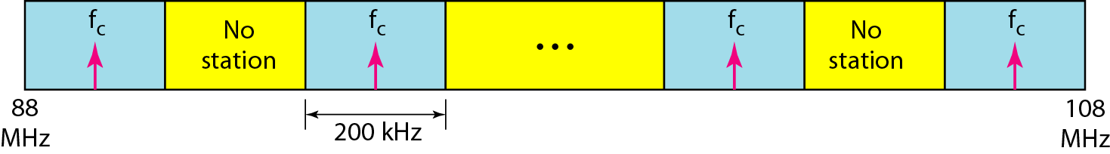
Frequency-division multiplexing (FDM)

Slide 6
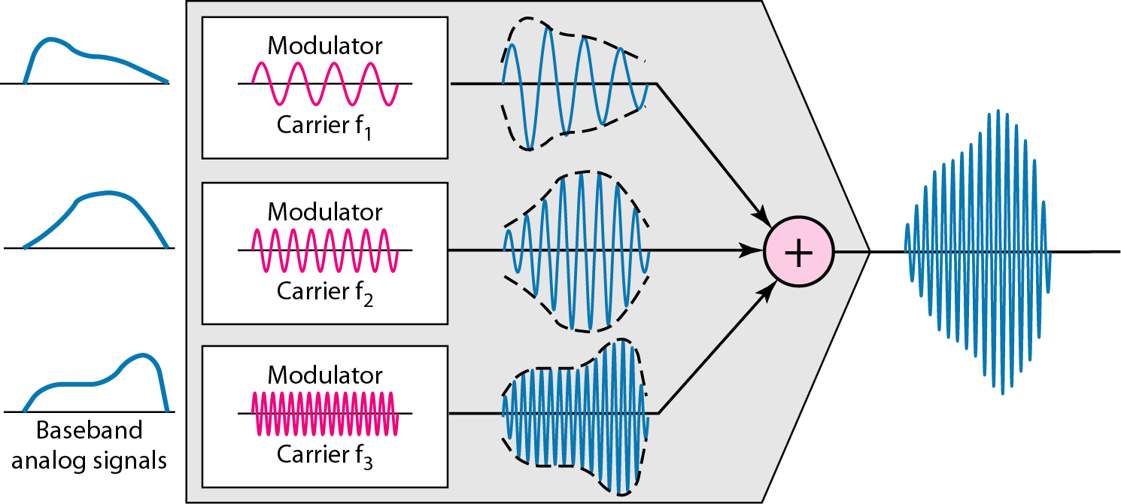
FDM Process

Slide 7
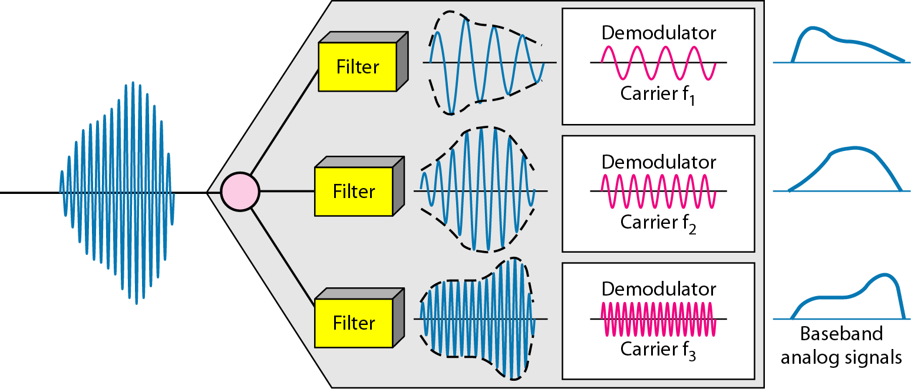
FDM demultiplexing

Slide 8
Assume that a voice channel occupies a bandwidth of 4 kHz. We need to combine three voice channels into a link with a bandwidth of 12 kHz, from 20 to 32 kHz. Show the configuration, using the frequency domain. Assume there are no guard bands.
Solution
We shift (modulate) each of the three voice channels to a different bandwidth, as shown in Figure. We use
the 20 to 24 kHz bandwidth for the first channel,
the 24 to 28 kHz bandwidth for the second channel, and
the 28 to 32 kHz bandwidth for the third one.
Then we combine them.

Slide 9
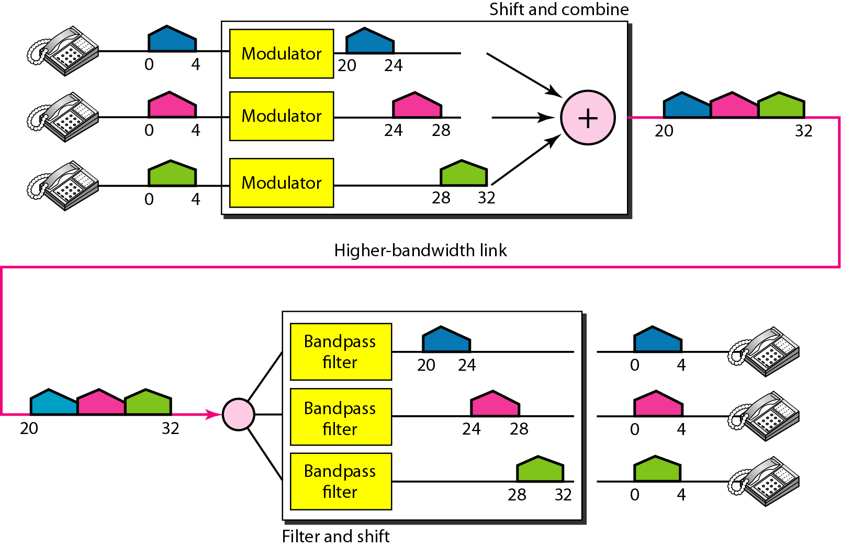
Figure 6.6 Example 6.1

Slide 10
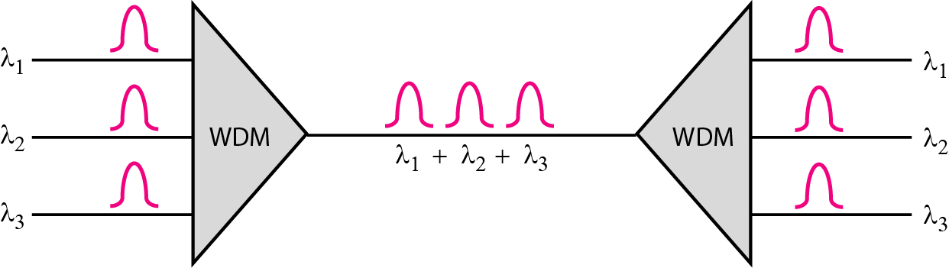
Wavelength-Division Multiplexing (WDM)

Slide 11
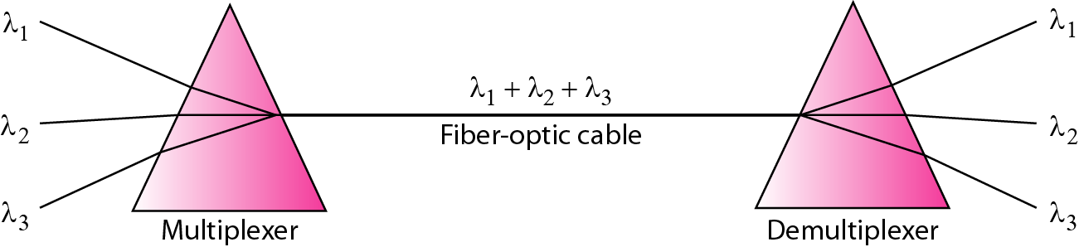
Prisms in wavelength-division multiplexing and demultiplexing

Slide 12
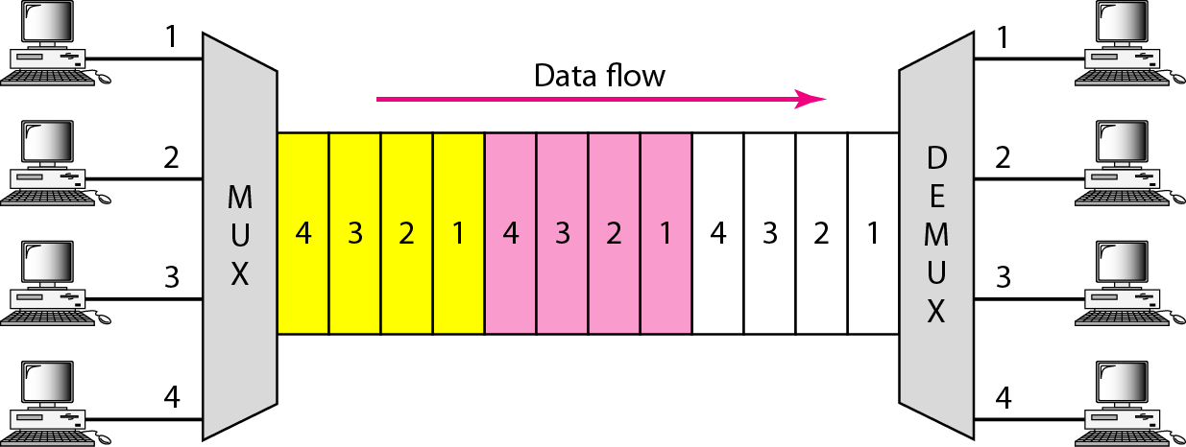
Time Division Multiplexing (TDM)

Slide 13
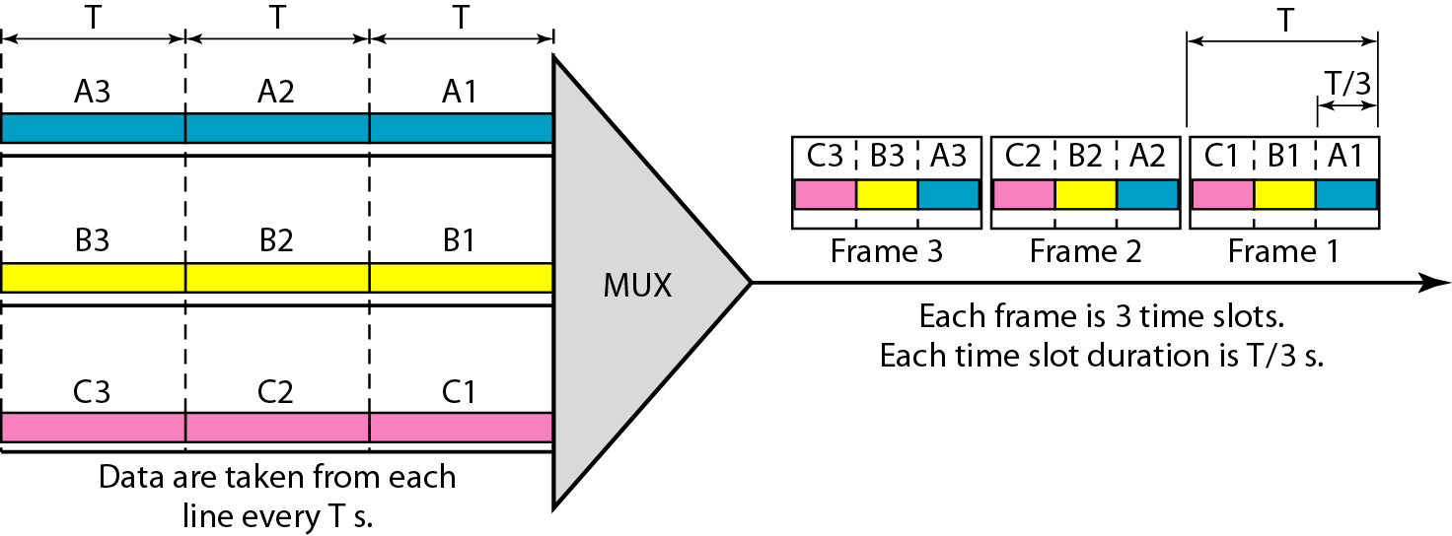
Time-Division Multiplexing

